Slide 1
Summary of the main findings of 2023 Survey of Primary Producers and Downstream Business Suppliers for the Unfair Trading Practices Enforcement Authority
June 2023
C23-045

Slide 2
Research Background
The Unfair Trading Practices (UTP) Regulations were signed into Irish law on 28th April 2021 and give effect to the provisions of the EU Directive on unfair trading practices in business-to-business relationships in the agricultural and food supply chain.
Under these Regulations, weaker suppliers are protected from unfair trading practices of stronger buyers and provides that complaints can be made within certain categories according to the annual turnover of a supplier compared to a buyer.
In 2022, Coyne Research conducted two surveys relating to awareness and understanding of these regulations.
A second wave of the research took place in May 2023.
Following on from the benchmark survey last year, the primary research objective can be described as;
“To measure awareness & understanding of the UTP Regulations and to inform the UTP related issues of most concern to Agri food suppliers.”

Slide 3
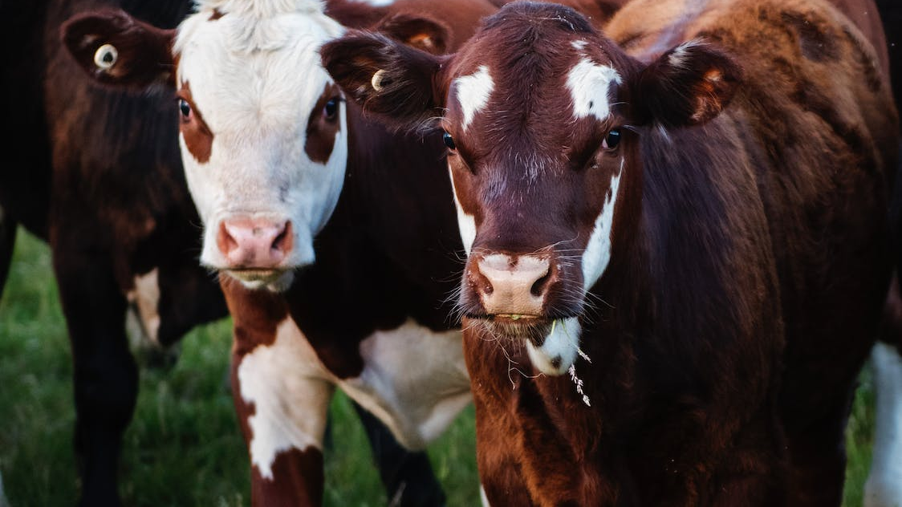
Section #1
Primary Producer Survey

Slide 4
Research Methodology – Primary Producer Online Survey
The EA (Enforcement Authority) were responsible for distributing the survey link on the Department of Agriculture, Food and the Marine website and distributing the survey link with other partners.
2,560 Primary Producers responded to the online survey – comparisons are made versus the benchmark study conducted in 2022 where possible.
The margin of error on a sample of this size is +/- 1.8% at the 95% Confidence level.
Online Survey Amongst Primary Producers
10-12 Minute Survey
Fieldwork took place between the 2nd and the 17th of May 2023.

Slide 5
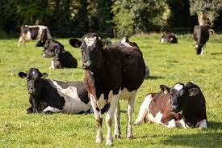
Profile of Primary Producers
Base: Primary Producers – 2,560
Q.1/2
2023
2022
Main Buyers of Agricultural Products
Main Sector
%
%
Meat Processor
Dairy Co-Operative
Traders or wholesalers of agricultural and/or food products
Marts
Producer Organisation
Other primary processors of agri-food products
Secondary and further processors of food products
Farm to farm
Dairy Processor (non Co-Operative)
Retailers
Beef
(56)
Dairy
(17)
Sheep
(16)
Cereals
(4)
Poultry
(2)
Other
(5)
( ) = 2022 Data
In line with the benchmark study, over half of all primary producers were Beef farmers, followed by 19% in Dairy and 15% in Sheep. Main buyers of Agri products were Meat Processors and Dairy Co-ops.

Slide 6
Awareness & Understanding of the Unfair Trading Practices Regulations
Base: Primary Producers - 2560
Q.3/4
Where Heard
Heard of the Unfair Trading Practices Regulations
N - 1591
%
Farming Print Media
%
Farming organisation
Radio
Yes
TV/TV programme
No
(50)
%Yes
Mainstream Print Media
(50)
(+12%)
Social Media
Online
Family or friends
( ) = 2022 Data
Buyer
Nearly 2 in 3 claim to have heard of the unfair trading practices regulations (+12%) versus the benchmark survey. Most primary producers have heard of the regulations through Farming Print Media followed by Farming Organization and Radio.

Slide 7
Awareness & Understanding of the Unfair Trading Practices Regulations
Base: Primary Producers - 2560
Q.3/5
Heard of the Unfair Trading Practices Regulations
2023
2022
Understanding of UTPR
N - 1591
%
They protect against unfair trading practices
They protect farmers, farmers organisations, fishers and other weaker suppliers of agricultural and food products against stronger buyers
Just heard the name
Established an enforcement authority
I don't know anything about them
I do not think they do anything
%
Yes
No
(50)
(50)
(+12%)
Over half of Primary Producers understand that the unfair trading practices regulations protect against unfair trading practices (+8% increase from last year) followed by protection against stronger buyers.

Slide 8
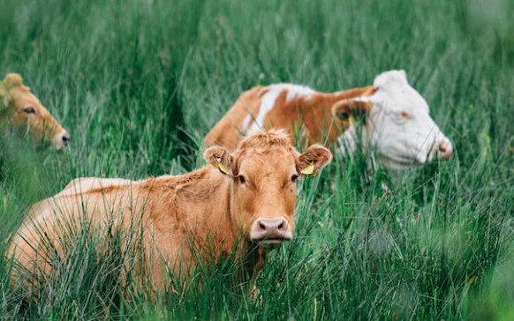
Confidence That Unfair Trading Practices
Regulations Protect Against Unfair Trading Practices
Base: Primary Producers - 2560
Q.14a/b
Reasons for no Confidence
%
Base: All who are not confident in protection against UTP - 547
Very Confident
(5)
%
26%
No confidence in the government/regulators
Big corporations/companies seem to always win
Buyers have too much power
Farmers forced to be price-takers
Haven’t seen any successful complaints
There is a cartel in farming industry
Small producers won’t be protected
Buyers control price
Somewhat Confident
(4)
Neither/Nor
(3)
51% Not Confident in 2022
Not Confident
(2)
% Not Confident - 51%
51%
Not at all Confident
(1)
*All other mentions 6% or less
Mean:
2.5
Half are not confident that unfair trading practices regulations protect against unfair trading practices. The main reason cited is having no confidence in the government/regulators. This is followed by big corporations/companies seem to always win and buyers having too much power.

Slide 9
Subjected to Unfair Trading Practice – Overview
Base: Primary Producers - 2560
Any Black
Any Grey
Any Grey or Black
%
%
%
(24%)
(6%)
(25%)
( ) 2022 Benchmark
Similar to 2022, 1 in 4 primary producers claim to have been subjected to at least one black UTP with only 7% citing grey. Overall marginal increase in being subjected to any UTP (28%).

Slide 10
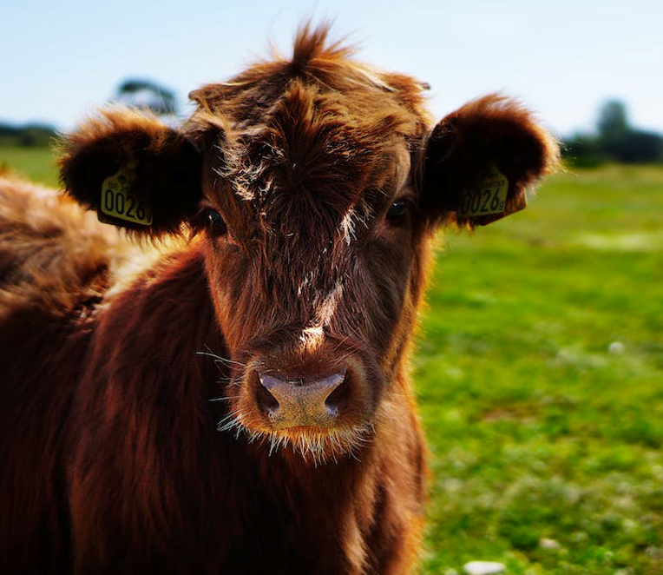
(Black) Unfair Trading Practices Subjected to in Past 12 Months
Base: Primary Producers – 2560
Q.6
Total
2023
2022
( ) 2022
%
Unilateral contract changes by the buyer
Misuse of trade secrets by the buyer
Payment later than 30 days for perishable agricultural and food products
Commercial retaliation by the buyer
Payment later than 60 days for other agricultural and food products
Risk of loss and deterioration transferred to the supplier
Refusal of written confirmation of a supply agreement by the buyer, despite request of the supplier
Transferring the costs of examining customer complaints to the supplier
Short-notice cancellations of perishable agricultural and food products
Payment not related to a specific transaction
None of these
26%
Any
(24%)
*IN PAST 2 YEARS IN 2022 STUDY
In line with the benchmark study, 1 in 4 claim to have been subjected to a black UTP in the past 12 months. Most salient practices were unilateral contract changes, misuse of trade secrets and payment later than 30 days.

Slide 11
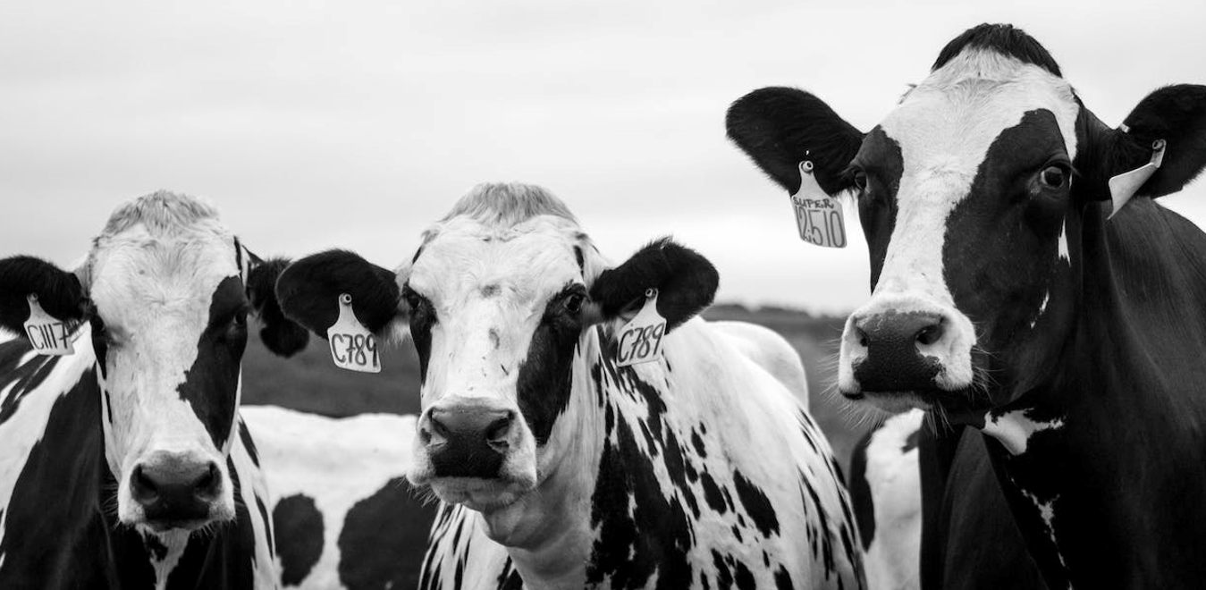
(Grey) Unfair Trading Practices Subjected to in Past 12 Months
Base: Primary Producers - 2560
Q.7
Total
( ) 2022
2023
2022
%
The buyer returns unsold products to the supplier without paying for those unsold products
Payment by the supplier for marketing
Payment by the supplier for promotion
Payment by the supplier for advertising
Payment by the supplier for stocking, display and listing
Payment by the supplier for staff of the buyer, fitting out premises
None of these
7%
Any
(6%)
93
94
*IN PAST 2 YEARS IN 2022 STUDY
7% of Primary Producers report being subjected to a grey UTP (in line with the benchmark survey).

Slide 12
Estimated Cost to Business Arising From Unfair Trading Practices
Base: Primary Producers Subject to Unfair Trading Practices - 709
Q.8
Total
Beef
Dairy
Sheep
Cereals, Poultry, Other
Base: 346
Base: 163
Base: 92
Base: 108
%
%
%
%
%
Less than 0.5%
0.5-1%
1-2%
2-5%
Greater than 5%
Don’t Know
Mean
3.6%
(3.3%)
3.7%
(3.5%)
3.8%
(3.1%)
3.0%
(2.5%)
3.4%
(3.7%)
( ) = 2022 Data
In line with the benchmark study, 4 in 10 claimed to be unsure of the estimated cost to business.

Slide 13
Attitudes Towards Effect of Unfair Trading
Practices Regulations
Base: Primary Producers - 2560
Q.15a/b
Q.15a In your opinion, have the prohibited practices in the Unfair Trading Practices Regulations weakened or strengthened the position of weaker suppliers against stronger buyers in the food supply chain?
Reasons for Weakening
%
Base: All who believe UTP regulations have weakened position of weaker suppliers- 107
Strengthened
32%
%
Somewhat Strengthened
Buyers have too much power
No faith in regulators/government
Small businesses cannot compete with stronger buyers
Small suppliers aren't supported
Suppliers are still price-takers
Makes no difference
Suppliers are still not receiving enough money
Fear of being dropped as a supplier
19% Weakened in 2022
It has made no difference
% Weakened- 19%
Somewhat weakened
Weakened
19%
Mean:
3.1
*All other mentions 4% or less
1 in 5 believe the unfair trading practices regulations has weakened the position of weaker suppliers. Buyers having too much power was the main reason expressed.

Slide 14
Raise Issue with any Operators/Bodies
Base: Primary Producers Subject to Unfair Trading Practices (Black or Grey) - 709
Q.9/10
Rating Success of Raising the Issue
2023
2022
Operators/Bodies
Base: 328
%
Very Successful
%
Buyer(s)
Associations to whom I belong
Unfair Trading Practices Enforcement Authority
Department of Agriculture, Food and the Marine
Irish Farmers’ Association
None of these
Somewhat Successful
12%
Neither/Nor
% Any - 46%
Somewhat Unsuccessful
69%
N/A
Very Unsuccessful
N/A
Net Score:
-53%
(-53%)
( ) = 2022 Data
1 in 4 raised issues with the buyer while 1 in 5 contacted member associations. However, only 12% found the experience of raising the issue successful. 1 in 2 who reported being subject to an unfair trading practice did not raise the issue with anyone – similar to 2022.

Slide 15
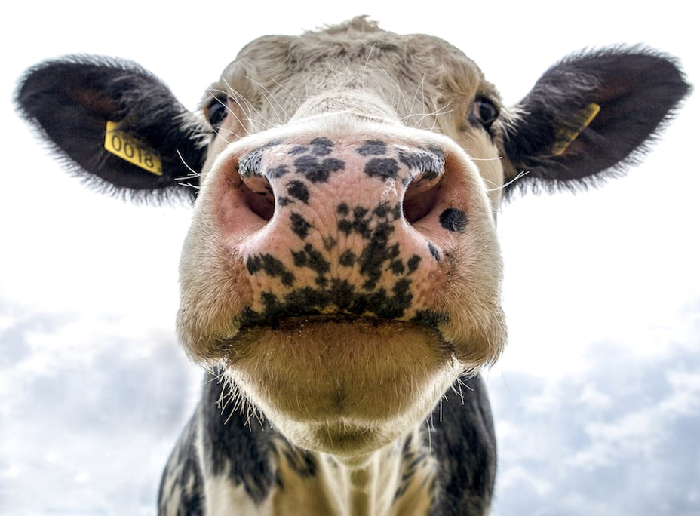
Reason for Not Raising the Issue with Anyone
Base: Primary Producers who did not raise their issue with any Operators/Bodies - 377
%
Q.11
Reason
2023
2022
%
It is common practice in the sector
Did not think the enforcement authority would be able to do anything
Fear of some form of retaliation from the buyer
Not sure what the right authority was
Did not think my representative body would be able to do anything
I am not a member of a representative body
It is too much hassle/effort
I can’t remember/don’t know
50% = 2022
N/A
The main reasons cited for not raising the issue was the perception it is common practice in the sector and thinking the enforcement authority would not be able to do anything. 1 in 5 unsure who the right authority is while 1 in 4 fear retaliation from the buyer.

Slide 16
Awareness of The Agri-Food Regulator And It’s Role
Base: Primary Producers - 2560
Q.16/17
Q. Are you aware that legislation is being progressed that will see the establishment of a new independent statutory Authority to take over the enforcement of unfair trading rules, An Rialálaí Agraibhia?
Q. Are you aware that the new Agri-Food Regulator is planned to have additional powers in price and market analysis and reporting and to promote fairness and transparency in the agricultural and food supply chain?
%
%
(17)
No
(15)
Yes
No
Yes
*New Question in 2023
*New Question in 2023
( ) = Downstream Business Supplier 2023
Circa 3 in 10 are aware that legislation is being progressed that will see the establishment of a new independent statutory Authority to take over the enforcement of unfair trading rules and that the new Agri-Food Regulator is planned to have additional powers in price and market analysis and reporting and to promote fairness and transparency in the agricultural and food supply chain. Awareness is significantly higher versus downstream business suppliers.

Slide 17
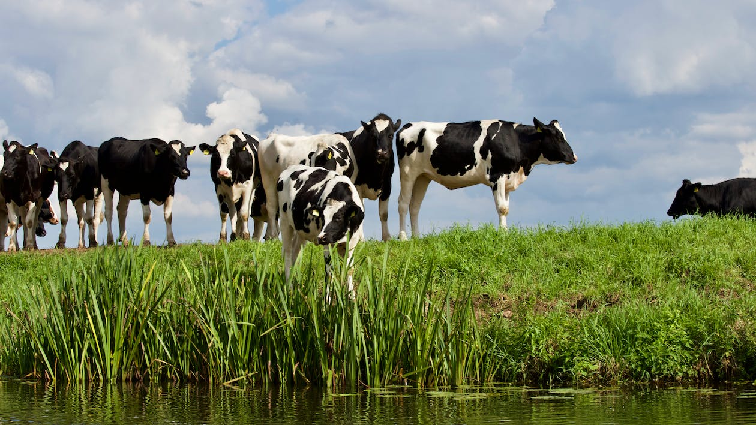
Section #2
Downstream Business Supplier Survey

Slide 18
Research Methodology – Downstream Business
Supplier Survey
A database of relevant Agri food/Amenity/ Horticulture suppliers was acquired using the Bill Moss database.
This was supplemented with leads from various websites to source downstream businesses e.g., Bord Bia, SuperValu, Origin Green, BIM, etc.
This was a representative sample of suppliers that operate downstream of primary producers in the agricultural and food products supply chain.
201 Agri Food Suppliers were interviewed by telephone.
CATI Telephone Survey Amongst 201 Agri Food Suppliers
10-12 Minute Survey
Fieldwork took place between the 2nd and the 15th of May 2023.

Slide 19
Profile of Business-to-Business Suppliers
Base: All B2B Suppliers - 201
Q.2/3
2023
Mainly Operated Stage of the Supply Chain
Main Buyers of Business’ Agricultural and Food Products
2022
2023
%
2022
%
Retailers
Traders or wholesaler of agricultural and/or food products
Food Service Industry (Hotel, restaurant etc.)
Primary processors of agricultural and/or food products
Secondary and further processors of agricultural and/or food products
Direct to Consumer*
52
Primary Processing
Any
100%
Secondary and Further Processing
Trader or Wholesaler
*Screened out if only direct to consumer
In line with the benchmark study, the top buyers of the businesses’ agricultural and food products were Retailers (52%), Traders or Wholesalers (29%), the Food Service Industry (24%), and Primary Processors (16%). A higher proportion of secondary processors were included in the 2023 sample.

Slide 20
Mainly Operated Sector
Base: All B2B Suppliers - 201
Q.4
Primary Processing
Secondary or Trader
/Wholesaler
2023
Base: 90
Base: 111
2022
%
-/+
-/+
Food horticulture
Confectionery
Seafood processor
Beverage (alcoholic and non-alcoholic drinks)
Ready meals
Dairy processor
Cereal processor
Pig meat processor
Beef processor
Frozen food processor
In line with the benchmark study, most businesses mainly operate in the Food horticulture sector – this is more prominent of businesses who mainly operate at the primary processing stage of the supply chain.

Slide 21
Business’ Most Recent Annual Sales in the Most Recent Financial Year
Base: All B2B Suppliers - 201
Q.5
Primary Processing
Secondary or Trader/Wholesaler
Total
Base: 90
Base: 111
2023
%
2022
2023
%
2022
2023
%
2022
Does not exceed €2 Million
70%
71%
71%
87%
84%
90%
€2 Million - €10 Million
€10 Million - €50 Million
€50 Million - €350 Million
#Prefer not to say
Mean:
11 Million
9 Million
13 Million
11 Million
11 Million
6 Million
#New option ‘23
Overall, the average annual turnover of Businesses was €11 million however with over half not exceeding €2 million.

Slide 22
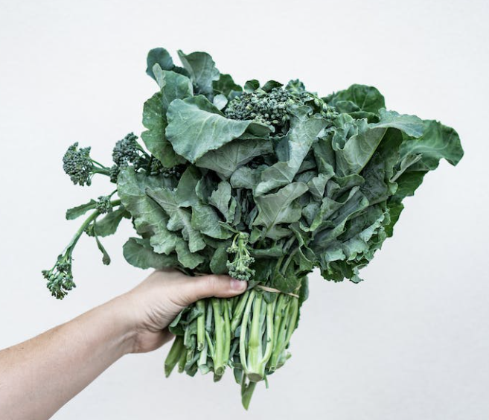
Awareness & Understanding of the Unfair Trading Practices Regulations – II
Base: All B2B Suppliers - 201
Q.8/10
Understanding of UTPR
Awareness of the Unfair Trading Practices Regulations
2023
2022
Base: 120
%
They protect against unfair trading practices
They protect farmers, farmers organisations, fishers and other weaker suppliers of agricultural and food products against stronger buyers
Just heard the name
Established an enforcement authority
I don't know anything about them
%
Yes
No
(51%)
(49%)
(%) = Vs 2022
Of those aware of the Regulations, nearly 4 in 10 are aware that they protect against Unfair Trading Practices. 1 in 3 understand that they protect farmers, farmers organisations, fishers and other weaker suppliers – significant increase versus 2022. Significant decrease in those claiming to have just heard the name versus 2022.

Slide 23
Subjected to Unfair Trading Practice – Overview
Base: All B2B Suppliers - 201
Any Black
Any Grey
Any Grey or Black
%
%
%
(49%)
(30%)
(53%)
( ) 2022 Benchmark
Lower incidence reported of being subjected to both black and grey UTPs. In total 45% claim to have been subjected to either (– 8% versus 2022).

Slide 24
(Black) Unfair Trading Practices Subjected to in the Past 12 Months
Base: All B2B Suppliers - 201
Q.11
2023
Total
2022
%
Payment later than 30 days for perishable agricultural and food products
Payment later than 60 days for other agricultural and food products
Short-notice cancellations of perishable agricultural and food products
Unilateral contract changes by the buyer
Transferring the costs of examining customer complaints to the supplier
Risk of loss and deterioration transferred to the supplier
Refusal of written confirmation of a supply agreement by the buyer, despite request of the supplier
Payment not related to a specific transaction
Misuse of trade secrets by the buyer
Commercial retaliation by the buyer
None of these
Any – 40%
(49%)
**NOTE 2022 WAS IN THE PAST 2 YEARS
(+9%)
When prompted with a list of Black Unfair Trading Practices, 4 in 10 businesses claim to have been subjected to at least one in the past 12 months. The highest being payment later than 30 days (26%) and payment later than 60 days (22%). This represents a significant decrease versus 2022. Sharp fallback in short notice cancellation of perishable agri-food products.

Slide 25
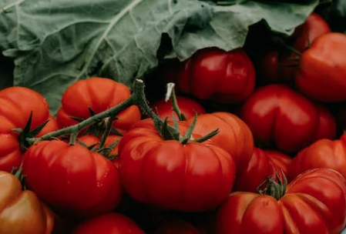
(Grey) Unfair Trading Practices Subjected to in the Past 12 Months
Base: All B2B Suppliers - 201
Q.12
2023
Total
2022
%
The buyer returns unsold products to the supplier without paying for those unsold products
Payment by the supplier for promotion
Payment by the supplier for marketing
Payment by the supplier for advertising
Payment by the supplier for stocking, display and listing
Payment by the supplier for staff of the buyer, fitting out premises
None of these
Any – 22%
(30%)
**NOTE 2022 WAS IN THE PAST 2 YEARS
78
When prompted with a list of Grey Unfair Trading Practices, circa 1 in 5 businesses claim to have been subjected to at least one in the past 12 months. Circa 1 in 10 report experiencing the buyer returning unsold products to the supplier without paying for those unsold products. This represents a decrease versus 2022.

Slide 26
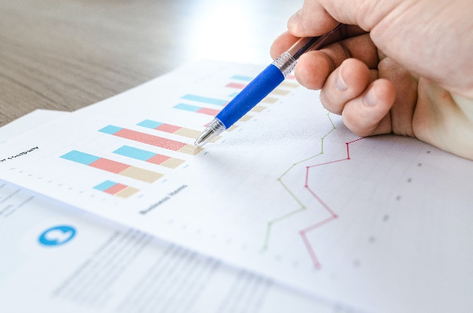
Estimated Cost to Business Arising From Unfair Trading Practices
Base: All B2B Suppliers Subject to the 16 Unfair Trading Practices -
Secondary or Trader /Wholesaler
Q.13
*Caution Small Base size
Primary Processing
Total
2023
%
2022
2023
%
2022
2023
%
2022
n: 91
n: 108
n: *35
n: 60
n: 56
n: 48*
*Base
size
too
small
to
analyse
Less than 0.5%
% of Annual Sales
0.5-1%
1-2%
2-5%
Greater than 5%
Don’t Know
*Caution Low Base Size
Average:
1.6%
1.6%
1.6%
1.4%
1.6%
In line with the benchmark study, average estimated percentage of annual sales cost because of Unfair Trading Practices was 1.6%. 37% believe the cost was less than 0.5% of annual sales.

Slide 27
Raise Issue with any Operators/Bodies?
Base: All B2B Suppliers Subject to the 16 Unfair Trading Practices - 91
Rating Success of Raising the Issue
Q.15/16
2023
2022
Operators/Bodies
Base: 49*
%
%
Buyer(s)
Associations to whom I belong
Unfair Trading Practices Enforcement Authority
None of these
Very Successful
(5)
34%
(40%)
Somewhat Successful
(4)
Any – 54%
Neither/Nor
(3)
Somewhat Unsuccessful
(2)
48%
(34%)
Very Unsuccessful
(1)
*Caution Low Base Size
Mean Score:
2.9
( ) = 2022 Data
Half raised their issue with the buyer while almost half didn’t raise the issue with anyone. 6% raised the issue with the Enforcement Authority. Amongst those who raised their issue, circa 1 in 3 claim a successful outcome (Lower versus the benchmark survey).

Slide 28
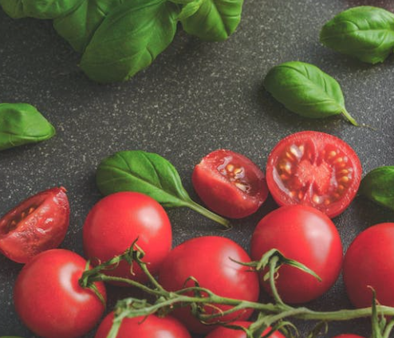
Reason for Not Raising the Issue with Anyone
Base: All B2B Suppliers who did not raise their issue with any Operators/Bodies – 42*
2023
Reason
Q.17
2022
%
Not sure what the right authority was
Fear of some form of retaliation from the buyer
#No issues/ wasn’t major
It is common practice in the sector
I didn't have the time
I am not a member of a representative body
I didn’t think I needed to/didn’t think of it
I wanted to deal with the supplier directly
Did not think my representative body would be able to do anything
Did not think the competent authority would be able to do anything
*Caution Low Base Size
# New Code
The top reasons for not raising the issue with anyone was not being sure what the right authority was (19%), fear of some form of retaliation from the buyer (17%) and not seeing the issue as major (16%). Retaliation and common practice has fallen back versus 2022.

Slide 29
Position of Weaker Suppliers Against Stronger Buyers
Base: All B2B Suppliers - 201
Q.21a
Primary Processing
Secondary or Trader/ Wholesaler
Aware of UTPR
Unaware of UTPR
Total
%
Base: 90
Base: 111
Base: 120
Base: 81
Q. In your opinion have the prohibited practices in the Unfair Trading Practices regulations weakened or strengthened the position of weaker suppliers against stronger buyers in the food supply chain?
%
%
%
%
Strengthened
(5)
32%
35%
32%
33%
29%
Somewhat
Strengthened
(24%)
(18%)
(32%)
(33%)
(17%)
(4)
It has made no difference
(3)
Somewhat Weakened (2)
10%
3%
13%
10%
8%
Weakened (1)
(10%)
(11%)
(9%)
(11%)
(10%)
( ) = 2022 Data
Mean Score:
3.3
3.4
3.2
3.3
3.3
Circa 1 in 3 believe the Unfair Trading Practices regulations strengthened the position of weaker suppliers against stronger buyers – an 8% increase from last year.

Slide 30
Key Summary – 2023
Nearly 2 in 3 Primary Producers claim to have heard of the unfair trading practices regulations (+12% increase versus 2022).
Over half of Primary Producers understand that the UTPR protect against unfair trading practices.
4 in 10 Business to Business suppliers (B2B) are aware that they protect against unfair trading practices.
1 in 4 Primary Producers & 45% B2B suppliers claim to have been subjected to an unfair trading practice.
When prompted, 1 in 4 Primary Producers & 40% of B2B suppliers claim to have been subjected to a Black UTP in the past 12 months.
7% of Primary Producers reported being subjected to a Grey UTP versus 1 in 5 B2B suppliers.
Half of the B2B suppliers subjected to a Black or Grey UTP raised the issue with the buyer. Fear of retaliation and noting it is common practice has fallen back versus 2022.
3 in 10 Primary Producers are aware that legislation is being progressed that will see the establishment of a new Independent Statutory Authority to take over the enforcement of unfair trading rules.
17% of B2B suppliers are aware.

Slide 31
Coyne Research 16 The Courtyard Kilcarbery Business Park Dublin D22F6K2 Ireland.
info@coyneresearch.com +353 (0)1-461 1040

